Slide 1

Day -8
Internet of Things (IoT)
Vinay Patankar, Madhukar

Slide 2
Steps to Boot OS on
“DB-410c”

Slide 3

Agenda
Windows 10 IoT Core OS
DB Update Tool
IoT Dashboard
DB Windows 10 IoT Core Image
Set up your device

Slide 4
DragonBoard 410c
Feature highlights:
OS Support: Android, Linux, and Windows 10
CPU: quad-core ARM Cortex A53 at up to 1.2 GHz per core, 32-bit and 64-Bit capable
Memory: LPDDR2/3 533 MHz Single-channel 32-bit (4.2GBps) non-POP/ eMMC 4.51 SD 3.0 )
Graphics: Adreno™ 306 400 MHz PC-class graphics
Video: 1080p HD video playback and capture with H.264 (AVC)
Camera: support for 13 megapixel camera with Wavelet Noise Reduction, JPEG decoder, and other post-processing techniques done in hardware
Connectivity and Location: Integrated 802.11 b/g/n, BT/FM, GPS
I/O Interfaces: HDMI Full-size Type A connector (1080p HD @ 30fps), 1x USB 2.0 micro B (device mode only), 2x USB 2.0 type A (host mode only), micro SD card slot
Expansion:
1x 40 pin low speed expansion connector: UART, SPI, I2S, I2C x2, GPIO x12, DC power
1x 60 pin high speed expansion connector: 4L-MIPI DSI, USB, I2C x2, 2L+4LMIPI CSI
Analog expansion connector: Headset, Speaker, FM antenna
Arduino compatibility through mezzanine board

Slide 5
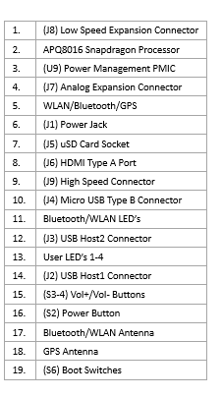
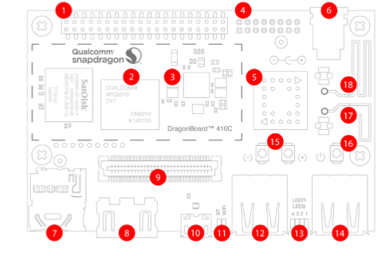
DragonBoard 410c

Slide 6
s.no | Arduino | Dragonboard 410c
1 | Arduino is a microcontroller, which is a part of the computer. It runs only one program again and again. | It is a mini computer with some Operating System. It can run multiple programs at a time.
2 | Arduino requires external hardware to connect to the internet | Dragonboard 410c can be easily connected to the internet using Wi-Fi dongles.
3 | Arduino can provide onboard storage with size of 32kb | Dragonboard 410c have 8GB storage on board, And also it provides an SD card port.
4 | Arduino has only one USB port to connect to the computer. | Dragonboard 410c has 2 USB ports and 1 Micro USB port to connect different devices.
5 | Arduino Uno has 20 GPIO pins. | Dragonboard 410c has 40 GPIO pins

Slide 7
Windows 10 IoT Core OS
1. Windows 10 IoT Core is the smallest version of Windows 10
2. It is designed to help you build connected things of all sizes and types.
3. Microsoft designed it to use in embedded systems.

Slide 8
Hardware Requirements
Bring Milk while coming home
The requirements for Windows 10 IoT Core depend on whether it is run in a headed or headless mode. Headed devices have a video display and use Windows video subsystem to address it. Headless devices have no display.
Memory
Headless
256 MB RAM (128 MB free to OS) / 2 GB Storage
Headed
512 MB RAM (256 MB free to OS) / 2 GB Storage
DragonBoard 410c Memory
Memory/storages: 1GB RAM / 8GB eMMC Storage
Processor
400 MHz or faster (x86 requires PAE, NX and SSE2 support)
DragonBoard 410c Processor
Quad-core ARM® Cortex® A53 at up to 1.2 GHz per core with both 32-bit and 64-bit support

Slide 9
Installation steps
1. Get the tools
2. Set up your device

Slide 10
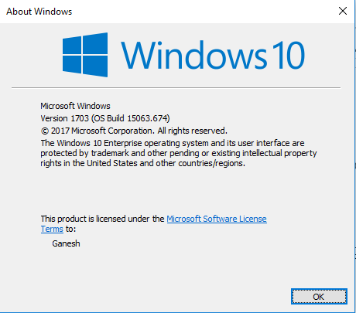
Get the tools
Download the tools and software you need to set up your board, build and explore Windows IoT.
1
Get Windows 10
Make sure you are running the public release of Windows 10
(build 14393 or better).
You can find your current build number by clicking the start button, typing "winver", and hitting the Enter key.
To upgrade, visit the Download Windows 10 page.

Slide 11
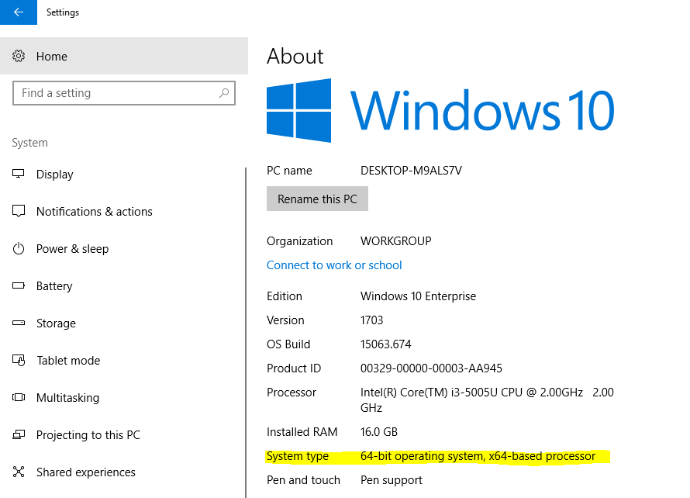
Get the tools
Download the tools and software you need to set up your board, build and explore Windows IoT.
2
Download and install the DragonBoard Update Tool
Download the DragonBoard Update Tool by selecting the download link appropriate for your PC: x86 or x64.
To determine whether your PC is x86 or x64,
1. Open Settings, and click/tap on the
System icon.
2. Click/tap on About on the left side. Under
PC on the right side, look to see if your
System type is either a 64-bit operating
system or a 32-bit operating system.
Continue…..

Slide 12
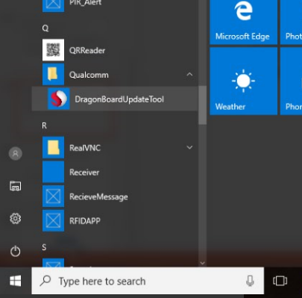
Get the tools
Download the tools and software you need to set up your board, build and explore Windows IoT.
2
Download and install the DragonBoard Update Tool
The installer will create a shortcut to the DragonBoard Update Tool on your desktop and in your
start menu,
under Qualcomm-> DragonBoardUpdate Tool.

Slide 13
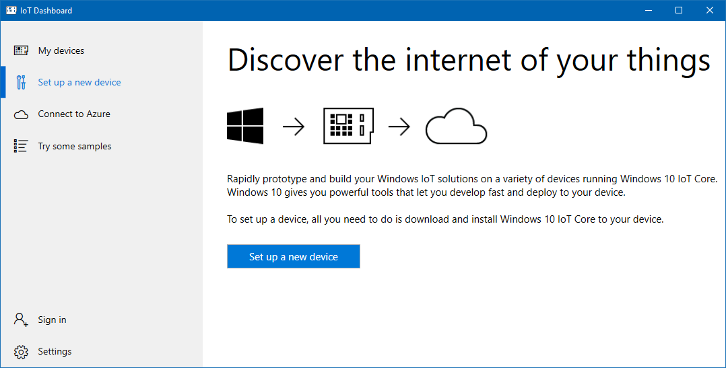
Get the tools
Download the tools and software you need to set up your board, build and explore Windows IoT.
3
Download and install Windows 10 IoT Core Dashboard
You will use the Dashboard to access your device through the "My devices" tab once you connect it to your network.
You can download Dashboard with following link
http://go.microsoft.com/fwlink/?LinkID=708576
Click to Download Dashboard

Slide 14
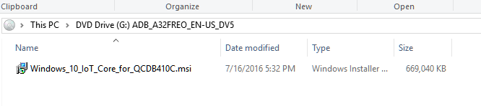
Get the tools
Download the tools and software you need to set up your board, build and explore Windows IoT.
4
Download the DragonBoard Windows 10 IoT Core Image
Click to Download Image File
Download Windows 10 IoT Core image from here.
Double click the downloaded ISO file. This will automatically mount the ISO as a new virtual CD-drive. (Look for a new CD-ROM drive)
The mounted virtual drive contains an installer file "Windows_10_IoT_Core_for_QCDB410C.msi".
Double click the file to start the installation.

Slide 15
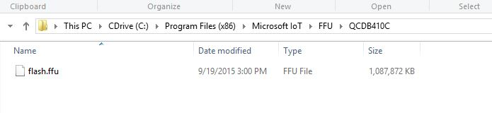
Get the tools
Download the tools and software you need to set up your board, build and explore Windows IoT.
4
Download the DragonBoard Windows 10 IoT Core Image
The installer creates a new directory: C:\Program Files (x86)\Microsoft IoT\FFU\QCDB410C\ which contains the DragonBoard410c image file "flash.ffu".
Do Remember the path which will we be used in further step

Slide 16
Set up your device
Download, flash and install Windows 10 IoT Core onto your device.
1
Set up your Dragonboard 410c and Install Windows 10 IoT Core
What you need
A PC running Windows 10
DragonBoard 410c
12V power supply Adapter
HDMI cable and monitor (HDMI monitors with a native resolution of 16:9 at 1280x720 are recommended)
USB keyboard and Mouse

Slide 17
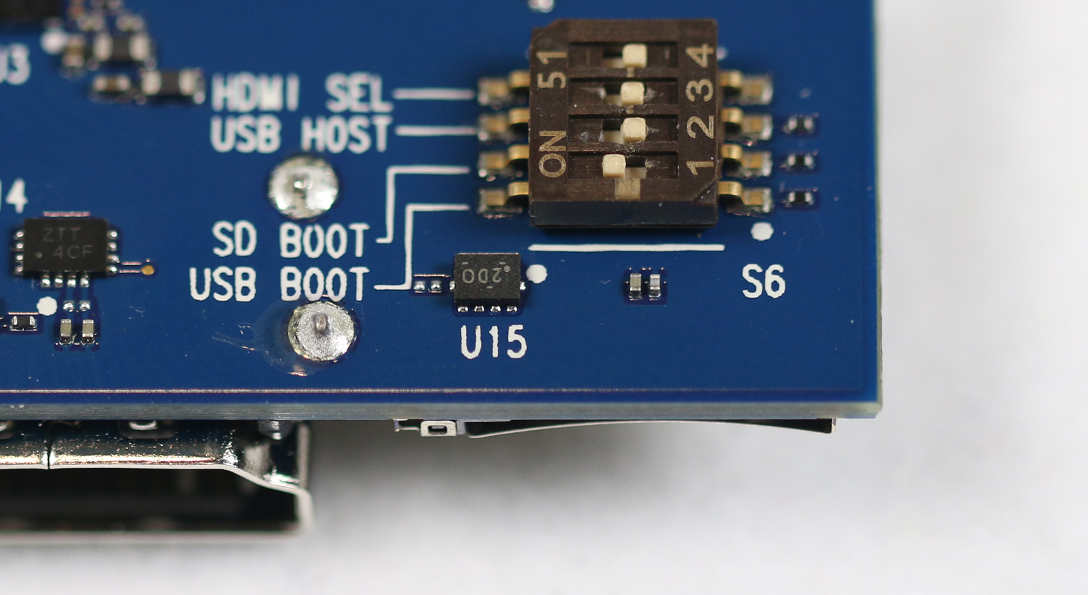
Set up your device
Download, flash and install Windows 10 IoT Core onto your device.
1
Set up your Dragonboard 410c and Install Windows 10 IoT Core
Connect the DragonBoard to the Host PC
First, we must enable download mode by setting the first boot switch on the back of the board
to: "USB Boot".
Note: The first of the four switches
is set to ON, and the other
3 switches are set to OFF.

Slide 18
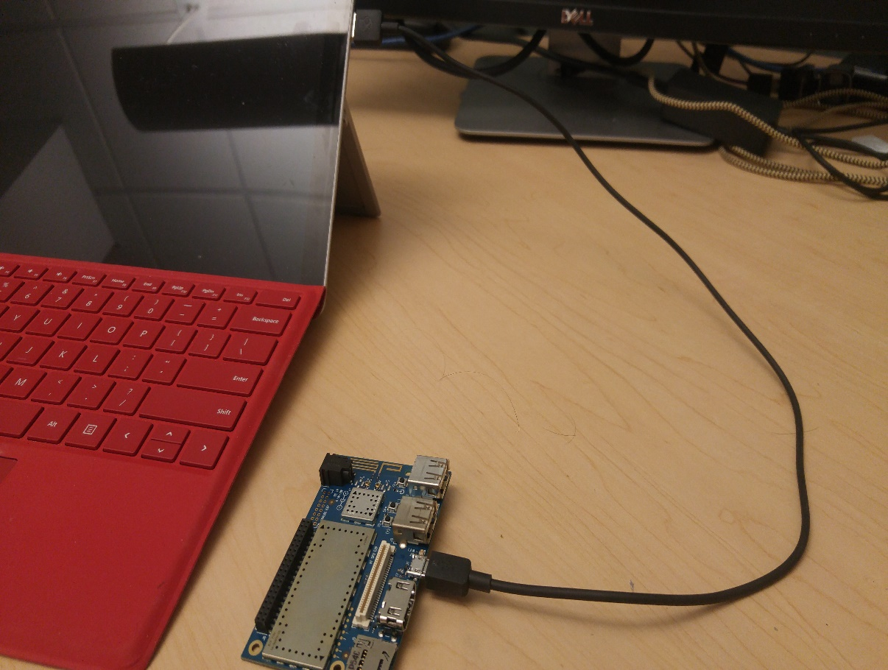
Set up your device
Download, flash and install Windows 10 IoT Core onto your device.
1
Set up your Dragonboard 410c and Install Windows 10 IoT Core
Connect the DragonBoard to the Host PC
Connect a USB cable to the DragonBoard’s
micro USB port and connect the other end
to an empty USB port on the Host PC,
Connect the DragonBoard to the Power supply.

Slide 19
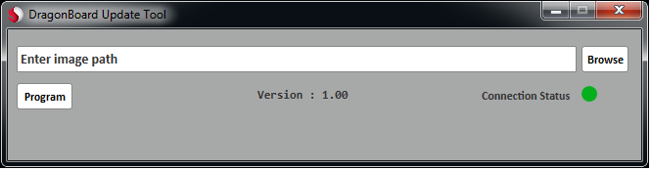
Set up your device
Download, flash and install Windows 10 IoT Core onto your device.
1
Set up your Dragonboard 410c and Install Windows 10 IoT Core
Download the Windows 10 IoT Core Image to the DragonBoard
Start the DragonBoard Update Tool you installed during the previous step.
The Update Tool should detect the DragonBoard and the Connection Status should show: "Connected".

Slide 20
Set up your device
Download, flash and install Windows 10 IoT Core onto your device.
1
Set up your Dragonboard 410c and Install Windows 10 IoT Core
In the DragonBoard Update Tool click the "Browse" button and locate the Win10 IoT Core Image file you downloaded during the HostPC setup.
Click the "Program" Button and wait for the image to be downloaded to the board..
Once the download is complete, disconnect the power supply and microUSB cable from the board and change the boot switches back to the OFF position.
The DragonBoard is now ready to boot into Win10 IoT Core OS.
NOTE: The download will overwrite any previous content of the eMMC memory.

Slide 21
Set up your device
Download, flash and install Windows 10 IoT Core onto your device.
1
Set up your Dragonboard 410c and Install Windows 10 IoT Core
First Boot
Connect Mouse, Keyboard and Display to the DragonBoard and plug in the power supply.
After a few seconds you should see the Win10 IoT boot-logo and shortly after you should see the Win10 IoT Core default application
The DragonBoard is now ready to boot into Win10 IoT Core OS.
NOTE: Make sure that the microUSB cable is not plugged-in, otherwise the USB devices will not be detected.

Slide 22
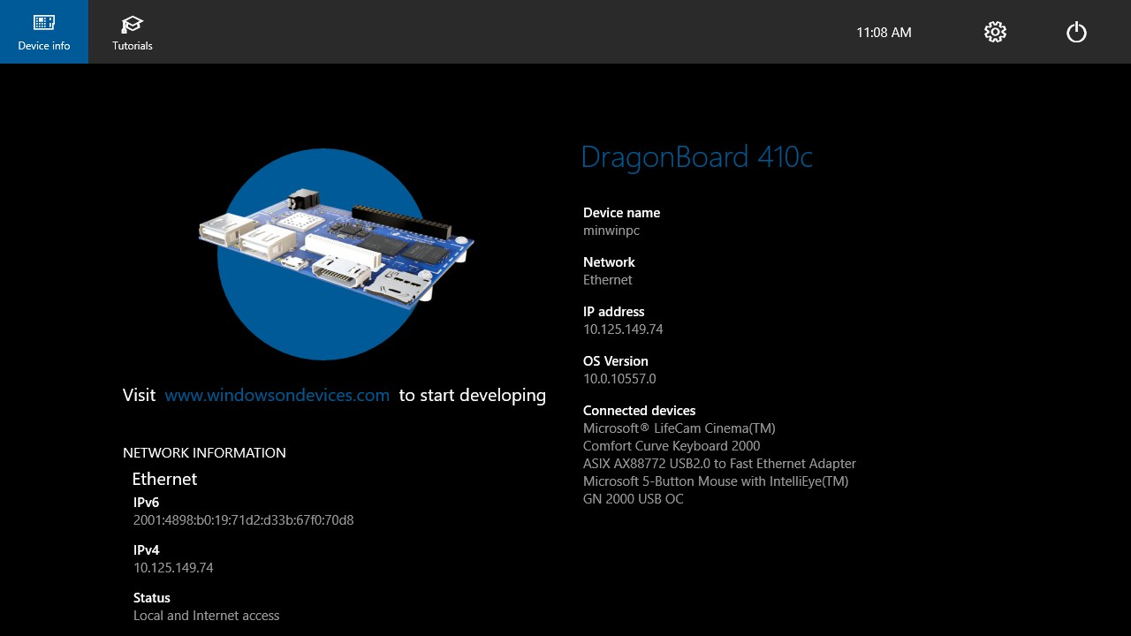
Set up your device
Download, flash and install Windows 10 IoT Core onto your device.
1
Set up your Dragonboard 410c and Install Windows 10 IoT Core
First Boot

Slide 23
Set up your device
Download, flash and install Windows 10 IoT Core onto your device.
2
Connect your device to the network
The DragonBoard410c has onboard Wi-Fi, but you may also choose to use a USB Ethernet Adapter to connect to a local network with an Ethernet cable.
Connecting to a Wireless Network
Click the Settings button next to the clock on the Win10 IoT Core default application.
On the Settings page, select "Network & Wi-Fi" via the menu on the left.
Your DragonBoard will automatically begin scanning for wireless networks.
Once your network appears in the list, select it and click the "Connect" button to connect.

Slide 24
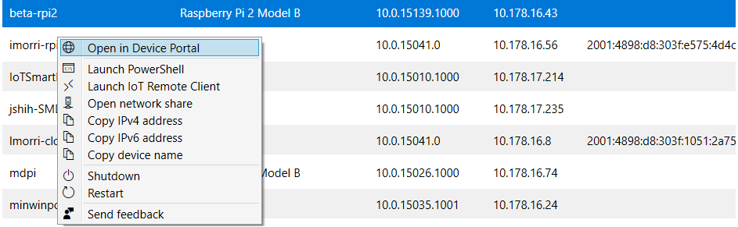
Set up your device
Username: Administrator Password: p@ssw0rd
Download, flash and install Windows 10 IoT Core onto your device.
2
Connect to your device

Slide 25
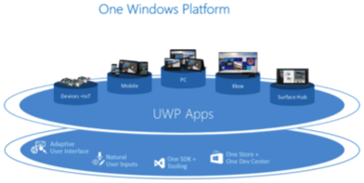
Why Windows 10 IoT Core?
Universal Windows Platform
The UWP API enables you to write one application and use it on your device, phone or desktop and gives you access to the thousands of Windows supported devices to use in your projects.

Slide 26
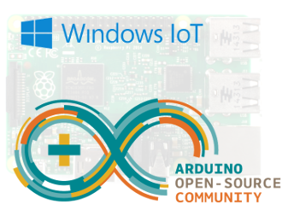
Why Windows 10 IoT Core?
Arduino Wiring API
Windows 10 IoT Core also supports the easy-to-use Arduino Wiring API used in Arduino sketches and libraries for direct hardware access.

Slide 27

Why Windows 10 IoT Core?
Visual Studio
To develop your applications, you can use the latest free Visual Studio Community Edition. Visual Studio is a professional quality development tool that is available free and includes universal app templates, a code editor, a powerful debugger, rich language support, and more.

Slide 28
Thank you

